Slide 1


38th IG Meeting
South Gas Regional Initiative
18th July 2016
Teleconference

Slide 2
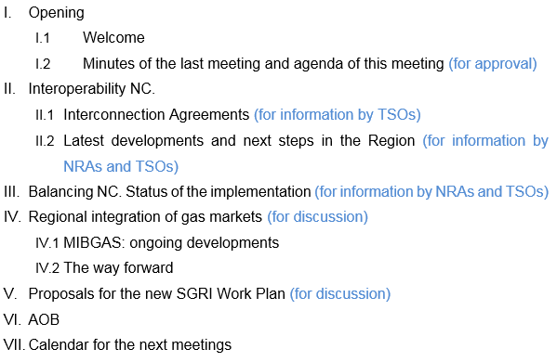
Agenda

Slide 3
III. Interoperability NC. Latest developments and next steps in the Region
IA for VIP Pirineos already received
IA for VIP Ibérico committed by the end of July
Issues to be addressed in the IA:
Interconnection Agreement: Each IP TSOs must ensure:
    Rules for flow control.
    Measurement principles for gas & quality
    Rules for the matching process
    Rules for allocation of gas quantities
    Communication procedures in exceptional events
    Settlement of disputes
    Amendment process of Interconnection Agreement
Common data exchange solutions

Slide 4
III. Interoperability NC. Latest developments and next steps in the Region
IA for VIP Pirineos already received
IA for VIP Ibérico committed by the end of July
Issues to be addressed in the IA:
Interconnection Agreement: Each IP TSOs must ensure:
    Rules for flow control.
      Designate the TSO who is responsible for steering the gas flow across IP.
      Matching process.
      OBA correction
      Flow control arrangements.
      Quantity of gas.
    Measurement principles for gas & quality
      Description of the metering station
      Gas quality parameters and ranges.
      Data validation.
      Data frequency and content
      Signals and alarms
      Access to measurement facility, verification, modification, calibration, etc.
      Etc.

Slide 5
III. Interoperability NC. Latest developments and next steps in the Region
IA for VIP Pirineos already received
IA for VIP Ibérico committed by the end of July
Issues to be addressed in the IA:
Interconnection Agreement: Each IP TSOs must ensure:
    Rules for the matching process:
      Rules of the communication and processing
      Matching rule for nominations and renominations
      Provision of data exchange for the matching process
    Rules for allocation of gas quantities
      Operational Balancing Account: as close to zero as possible.
      OBA takes into account characteristics of IP, linepack, capacities, gas flow dynamics.
      If other rule different to OBA is followed this rule must be published and network users are invited to comment.

Slide 6
III. Interoperability NC. Latest developments and next steps in the Region
IA for VIP Pirineos already received
IA for VIP Ibérico committed by the end of July
Issues to be addressed in the IA:
Interconnection Agreement: Each IP TSOs must ensure:
    Communication procedures in exceptional events
    Possible impact on quantities and quality
    Possible impact on confirmed quantities
    Expected and actual end of the exceptional event
  Settlement of disputes.
  Amendment process
Gas quality Data Publication. (Art. 16)
  Once per hour during the gas day (Wobbe index and GCV) every IP.
  Data availability, for so long?
Information provision on short term gas quality variation. (Art. 17)
  List of parties to receive gas quality information.
Common data exchange solutions (Art. 20 to 24)
  Document based data exchange
  Integrated data exchange
  Interactive data exchange

Slide 7
II. Interoperability NC. Implementation
Implementation
Interconnection Agreement (TSO):
  Interconnection Agreement Template : published on 11th April 2016
  Committed deadlines:
    France-Spain. IA at the end of June 2016 + 2 months of public consultation sent by email on 15th July
    Portugal-Spain. IA at the end of July 2016 + 2 months of public consultation
  Other adaptations to the IO NC (TSO)
NRAs assessment of the information received by the end of September (one month since formal communication).
Following positive evaluation: publication on the TSO’s web site.

Slide 8
III. Interoperability NC. Latest developments and next steps in the Region
  (for information by TSOs)

Slide 9
III. Balancing NC. Status of the implementation
(for information by NRAs and TSOs)
Spain
CNMC’s Circular 2/2015 establishing the balancing rules in the transmission network system – Jul. 2015 (Oct. 2016)
Issues already developed:
  1st Nov 2015:
    Information provision by users
    Rules for nomination/renominations
  16th December 2015:
    Come into operation the trading platform: MIBGAS
  1st March 2016:
    Procedure for accreditation of users
  12nd May 2016:
    Methodology of imbalance prices, neutrality charges and invoicing procedure - CNMC Resolution
  https://www.cnmc.es/es-es/energ%C3%ADa/circularesenerg%C3%ADa.aspx?udt_2808_param_detail=48404

Slide 10
III. Balancing NC. Status of the implementation
(for information by NRAs and TSOs)
Spain
Issues to be published soon:
Guarantees to cover possible imbalances – CNMC non binding report submitted to the Ministry in June. Pending of Ministry’s Resolution
Incentives for TSO to use balancing actions efficiently - to be approved by CNMC (by the end of 2016).
Parameters to define when a TSO balancing action is required – to be approved by the Ministry. A draft has been produced by the TSO (by 1st October 2016).

Slide 11
III. Balancing NC. Status of the implementation
(for information by NRAs and TSOs)
  (for information TSOs)

Slide 12
IV. Regional integration of gas markets
IV.1 MIBGAS: ongoing developments
(for discussion)
Iberian market integration:
    Portugal to incorporate MIBGAS exchange
  Short term target: implementation of implicit allocation mechanism with cross border tariffs
  Long term target: implementation of a trading region model
  Issues to be tackled:
  How much capacity put aside for implicit allocation
  Which kind of products? Daily/intraday/monthly?
  Coordination of explicit/implicit allocation mechanisms
  Interaction of implicit allocation with regulation in place (CAM, CMP, balancing and nominations/renominations)
  2 bilateral meetings between Spain and Portugal have been already held: 22 of June and 7 of July

Slide 13
IV. Regional integration of gas markets
IV.1 MIBGAS: ongoing developments
(for discussion)
Iberian market integration
Specific TF working on the necessary developments:
  To accommodate MIBGAS market rules to introduce the Portuguese balancing point and the implicit allocation mechanism among the Spanish and Portuguese balancing points. (Proposal presented by MIBGAS under discussion).
  To revise the Capacity Allocation Mechanisms (CAM rules) for the entry – exit capacity at the Iberian Virtual Interconnection Point, to include the implicit allocation mechanism (Responsible of proposal: ENAGAS and REN).
  To elaborate a proposal of procedures of communication among MIBGAS and the TSOs, regarding the availability of capacity and the allocation of capacity thought MIBGAS. (Responsible: REN, ENAGAS, and MIBGAS).
  To analyse and recommend other regulatory changes in order to facilitate the functioning of the implicit allocation model. (Responsible: ENAGAS, REN and MIBGAS).

Slide 14
IV. Regional integration of gas markets
IV.2 The way forward
(for discussion)
Market integration
Two approaches in the Region:
  France & Spain: continue with the harmonisation process of network codes, supervision, etc.
  Portugal & Spain: further integration. Wholesale gas market with implicit allocation.

Slide 15
VI. Proposals for the SGRI new Work Plan
Work Plan 2017-2018
I. First target: about the use of infrastructures in the Region:
Assessment of the use of interconnections in the Region from the implementation of the Network Codes: from 1st October 2014 to 30th September 2016.
  The current situation of gas interconnections in the Region.
    Capacities
    Flows
  The use of the gas interconnections.
    Booked capacities.
    Capacity used.
    Available capacities.
  Assessment of the capacity allocated since the implementation of the CAM network code.

Slide 16
VI. Proposals for the SGRI new Work Plan
I. First target: about the use of infrastructures in the Region (Cont.):
  Assessment of the gas flows and the congestion status.
    Analysis of the VIP’s congestion status.
    Use of anti-hoarding mechanisms in the region.
    Assessment of the CMP implementation.
  Recommendations
    For the allocation of capacity.
    For the congestion management.
  Conclusions.
  Deliverable Deadline: March 2017

Slide 17
VI. Proposals for the SGRI new Work Plan
II. Second target: about gas Balancing regimes in the region:
Follow-up of the Balancing regimes at national levels and in the interconnections. Assessment about unbalancing volumes, costs, number of TSO balancing actions, etc. (from 1st October 2017 to 30th September 2017):
  Sharing information in the region:
    NRAs will do the index and contents of the “template” report.
    Every TSO will complete the report about their own balancing zone.
  NRAs and TSOs will do a synthesis how the different balancing regimes are working the SGRI.
    Deliverable Deadline: December 2017

Slide 18
VI. Proposals for the SGRI new Work Plan
III Third target: Market integration
  Next steps to further market integration:
    Iberia.
      To accommodate MIBGAS market rules.
      To revise CAM rules at the Iberian VIP to accommodate implicit allocation mechanism.
      To elaborate a proposal of communication procedures among MIBGAS and TSOs.
      To implement the model.
          Deadline: According to Iberian gas deadlines.

Slide 19
VI. Proposals for the SGRI new Work Plan
III Third target: Market integration
  Next steps to further market integration:
    Iberia with France
      NRAs will analyse market rules (exchange) of every market.
      NRAs will assess market prices behavior.
      NRAs will make some recommendations and conclusions.
      Deliverable Deadlines: a) March 2017
      b) October 2017
      c) December 2017

Slide 20
VI. Proposals for the SGRI new Work Plan
IV. Fourth target: Tariffs
  TSO’s assessment of the current cross border transmission tariffs.
  NRAs analysis and conclusions.
      Deliverable Deadlines: 1) December 2017
      2) June 2018

Slide 21
VI. Proposals for the SGRI new Work Plan
V. Fifth target: Infrastructures.
  TSO’s TYNDP proposal.
  NRA’s assessment.
      Deliverable Deadlines: according to the PCI process

Slide 22
VI. Proposals for the SGRI new Work Plan
VI. Sixth target: Other possible pending issues:
  Interoperability.
    Follow up of the implementation of the job done in 2016.
  OSBB
    Follow up of the implementation of the job done in 2016.

Slide 23
VI. AOB

Slide 24
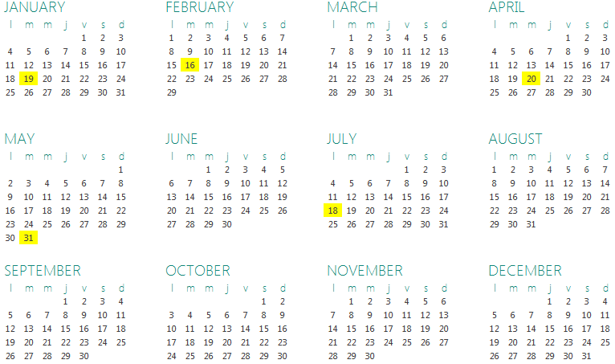
VII. Calendar for the next meetings
Next meetings: 4th October 2016

